Slide 1
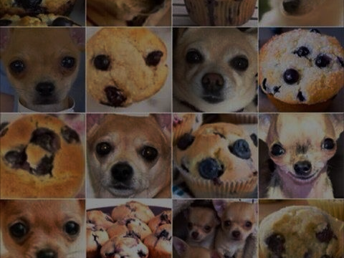
Bagel or Dog? What ready-made image recognition can accomplish today
@DJCORDHOSE, embarc

Slide 2
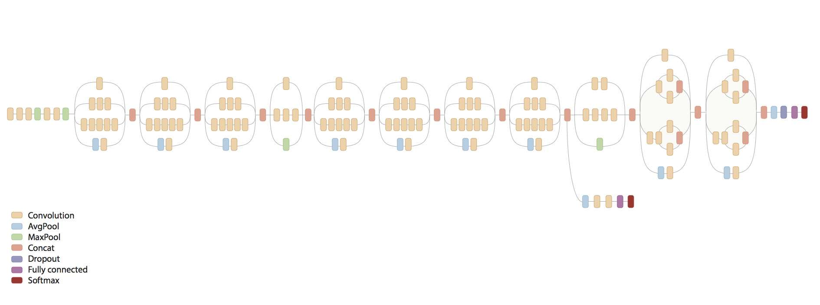
Google’s TensorFlow Inception Model provides out-of-the-box image recognition

Slide 3
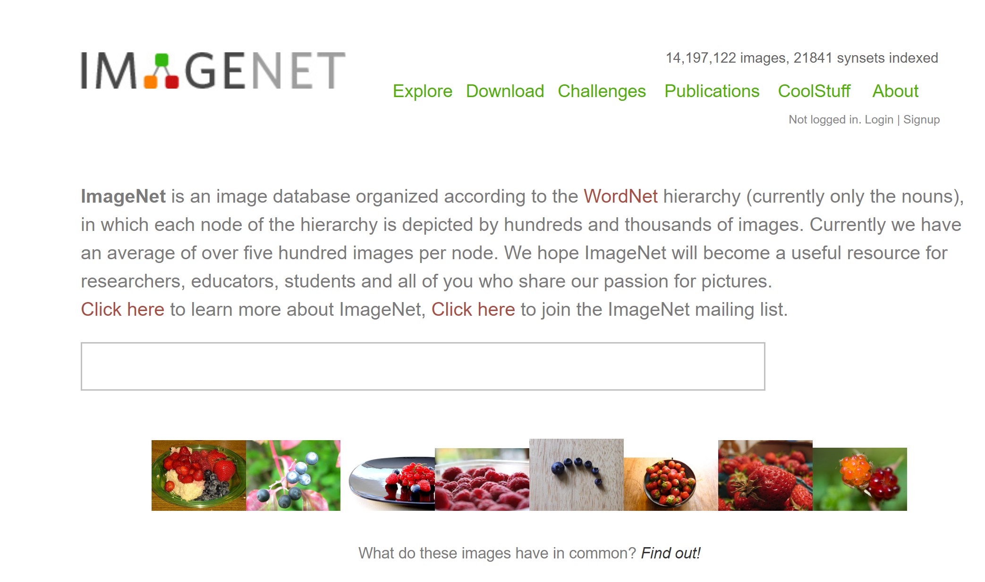
Trained on ImageNet

Slide 4
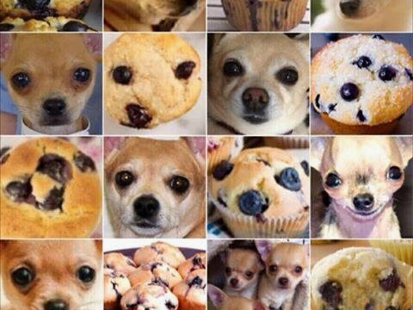
An Experiment
Is it powerful enough to recognize the Captchas like the ones created by Google?

Slide 5
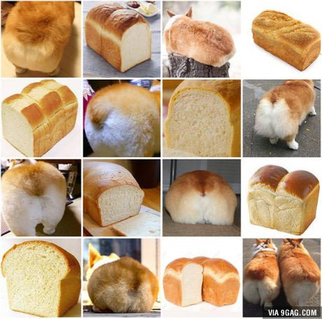

Slide 6
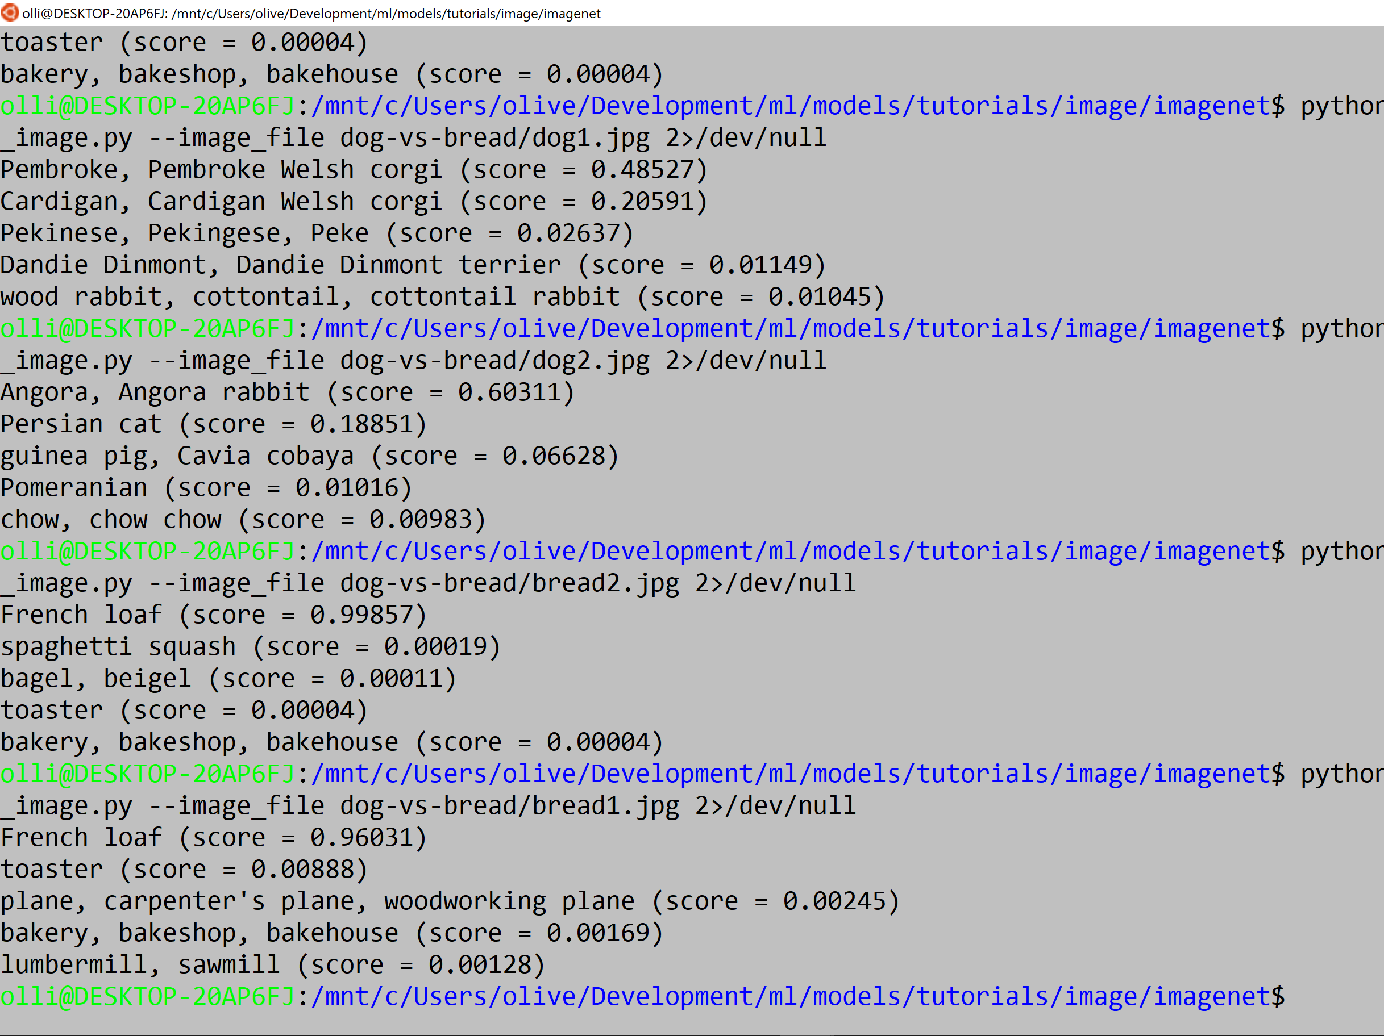

Slide 7
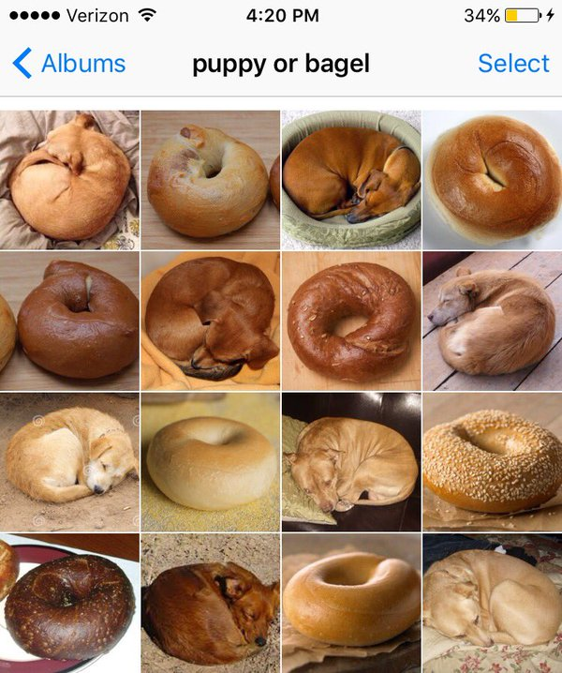

Slide 8
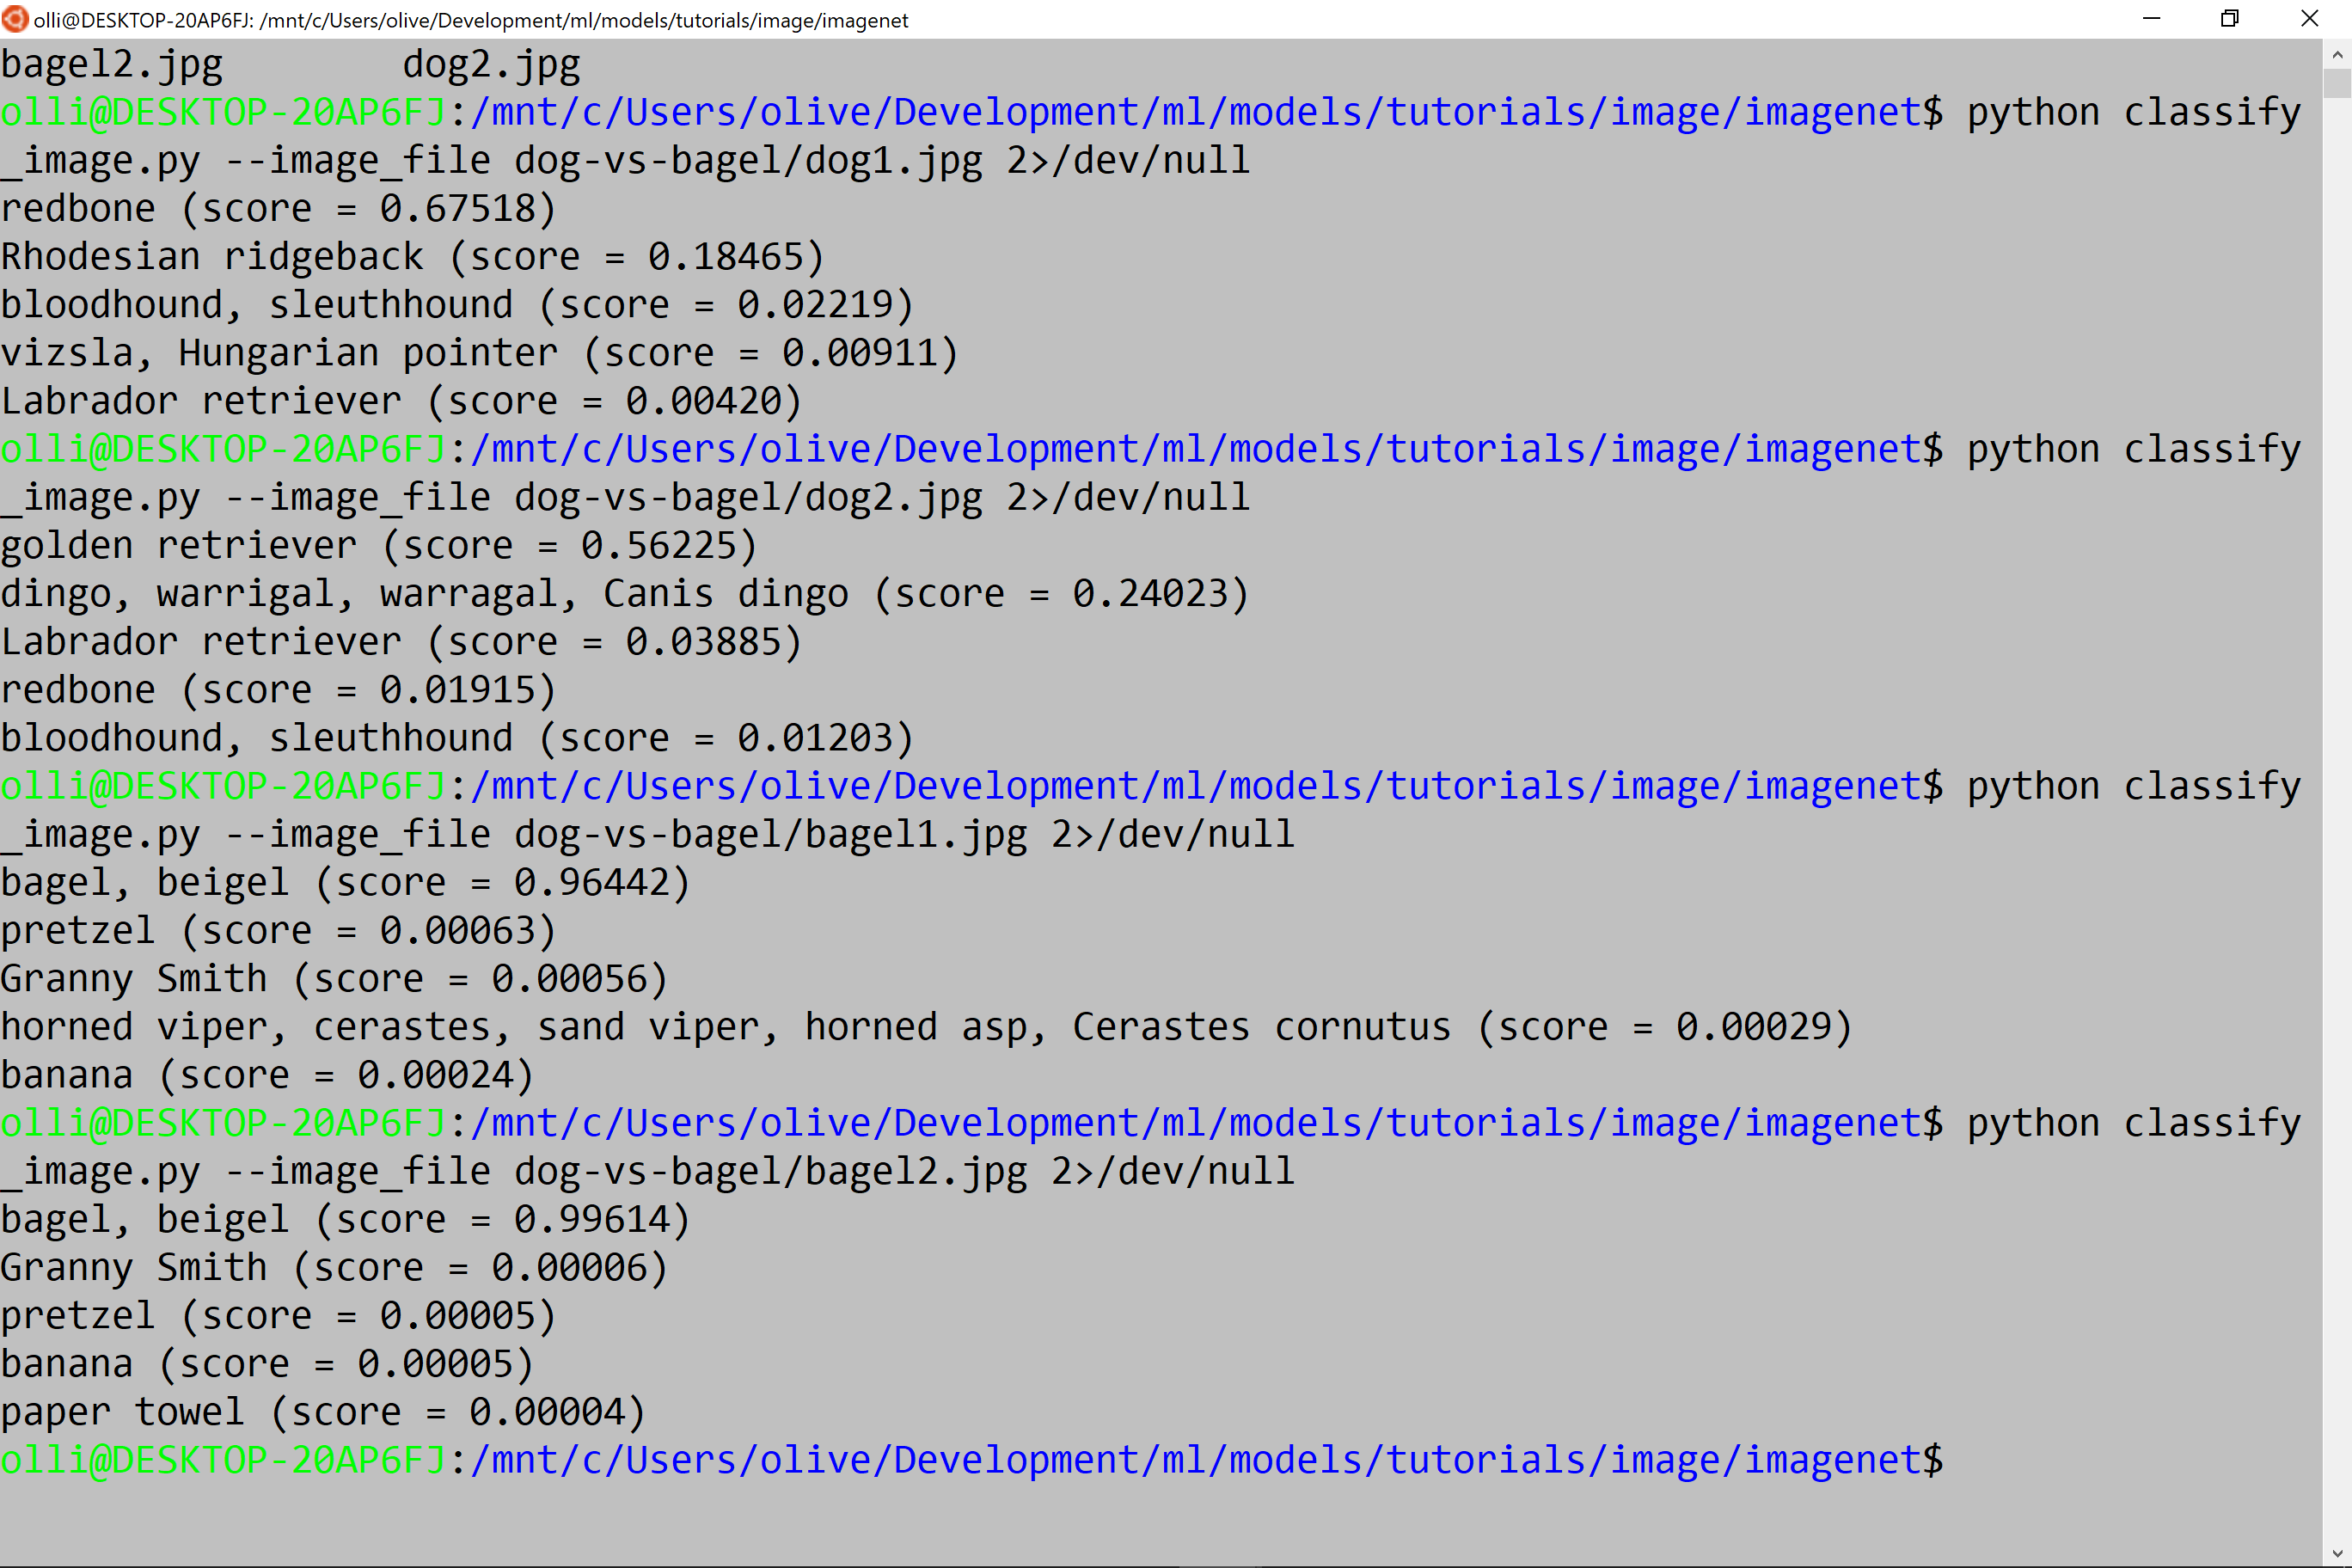

Slide 9
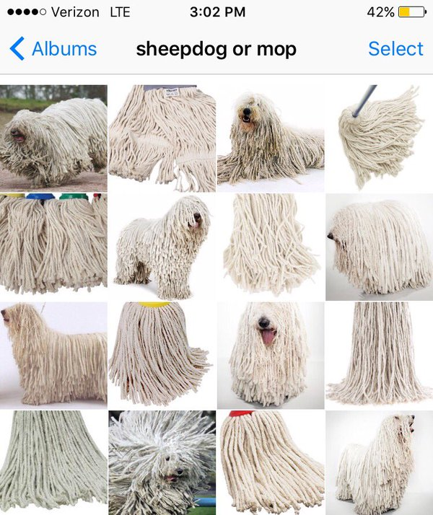

Slide 10
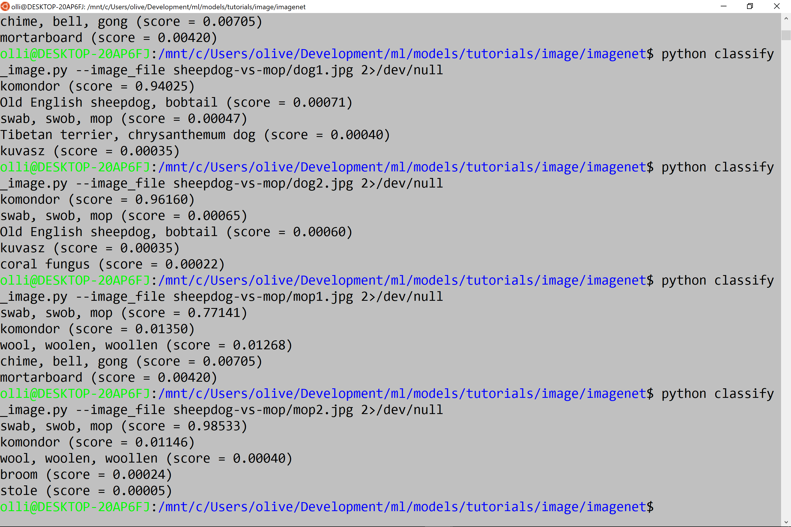

Slide 11
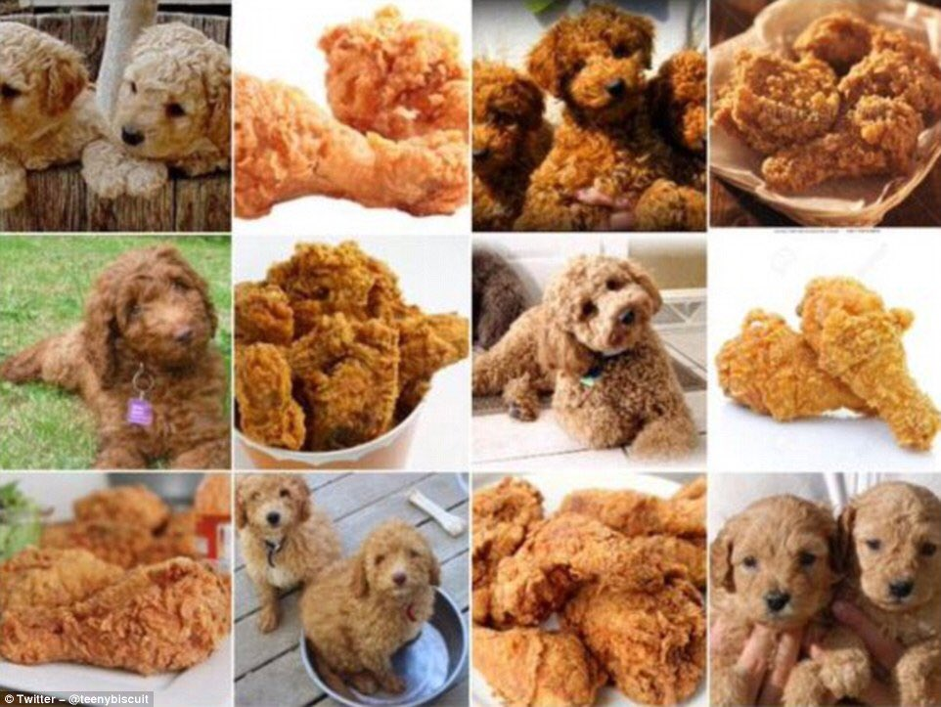

Slide 12
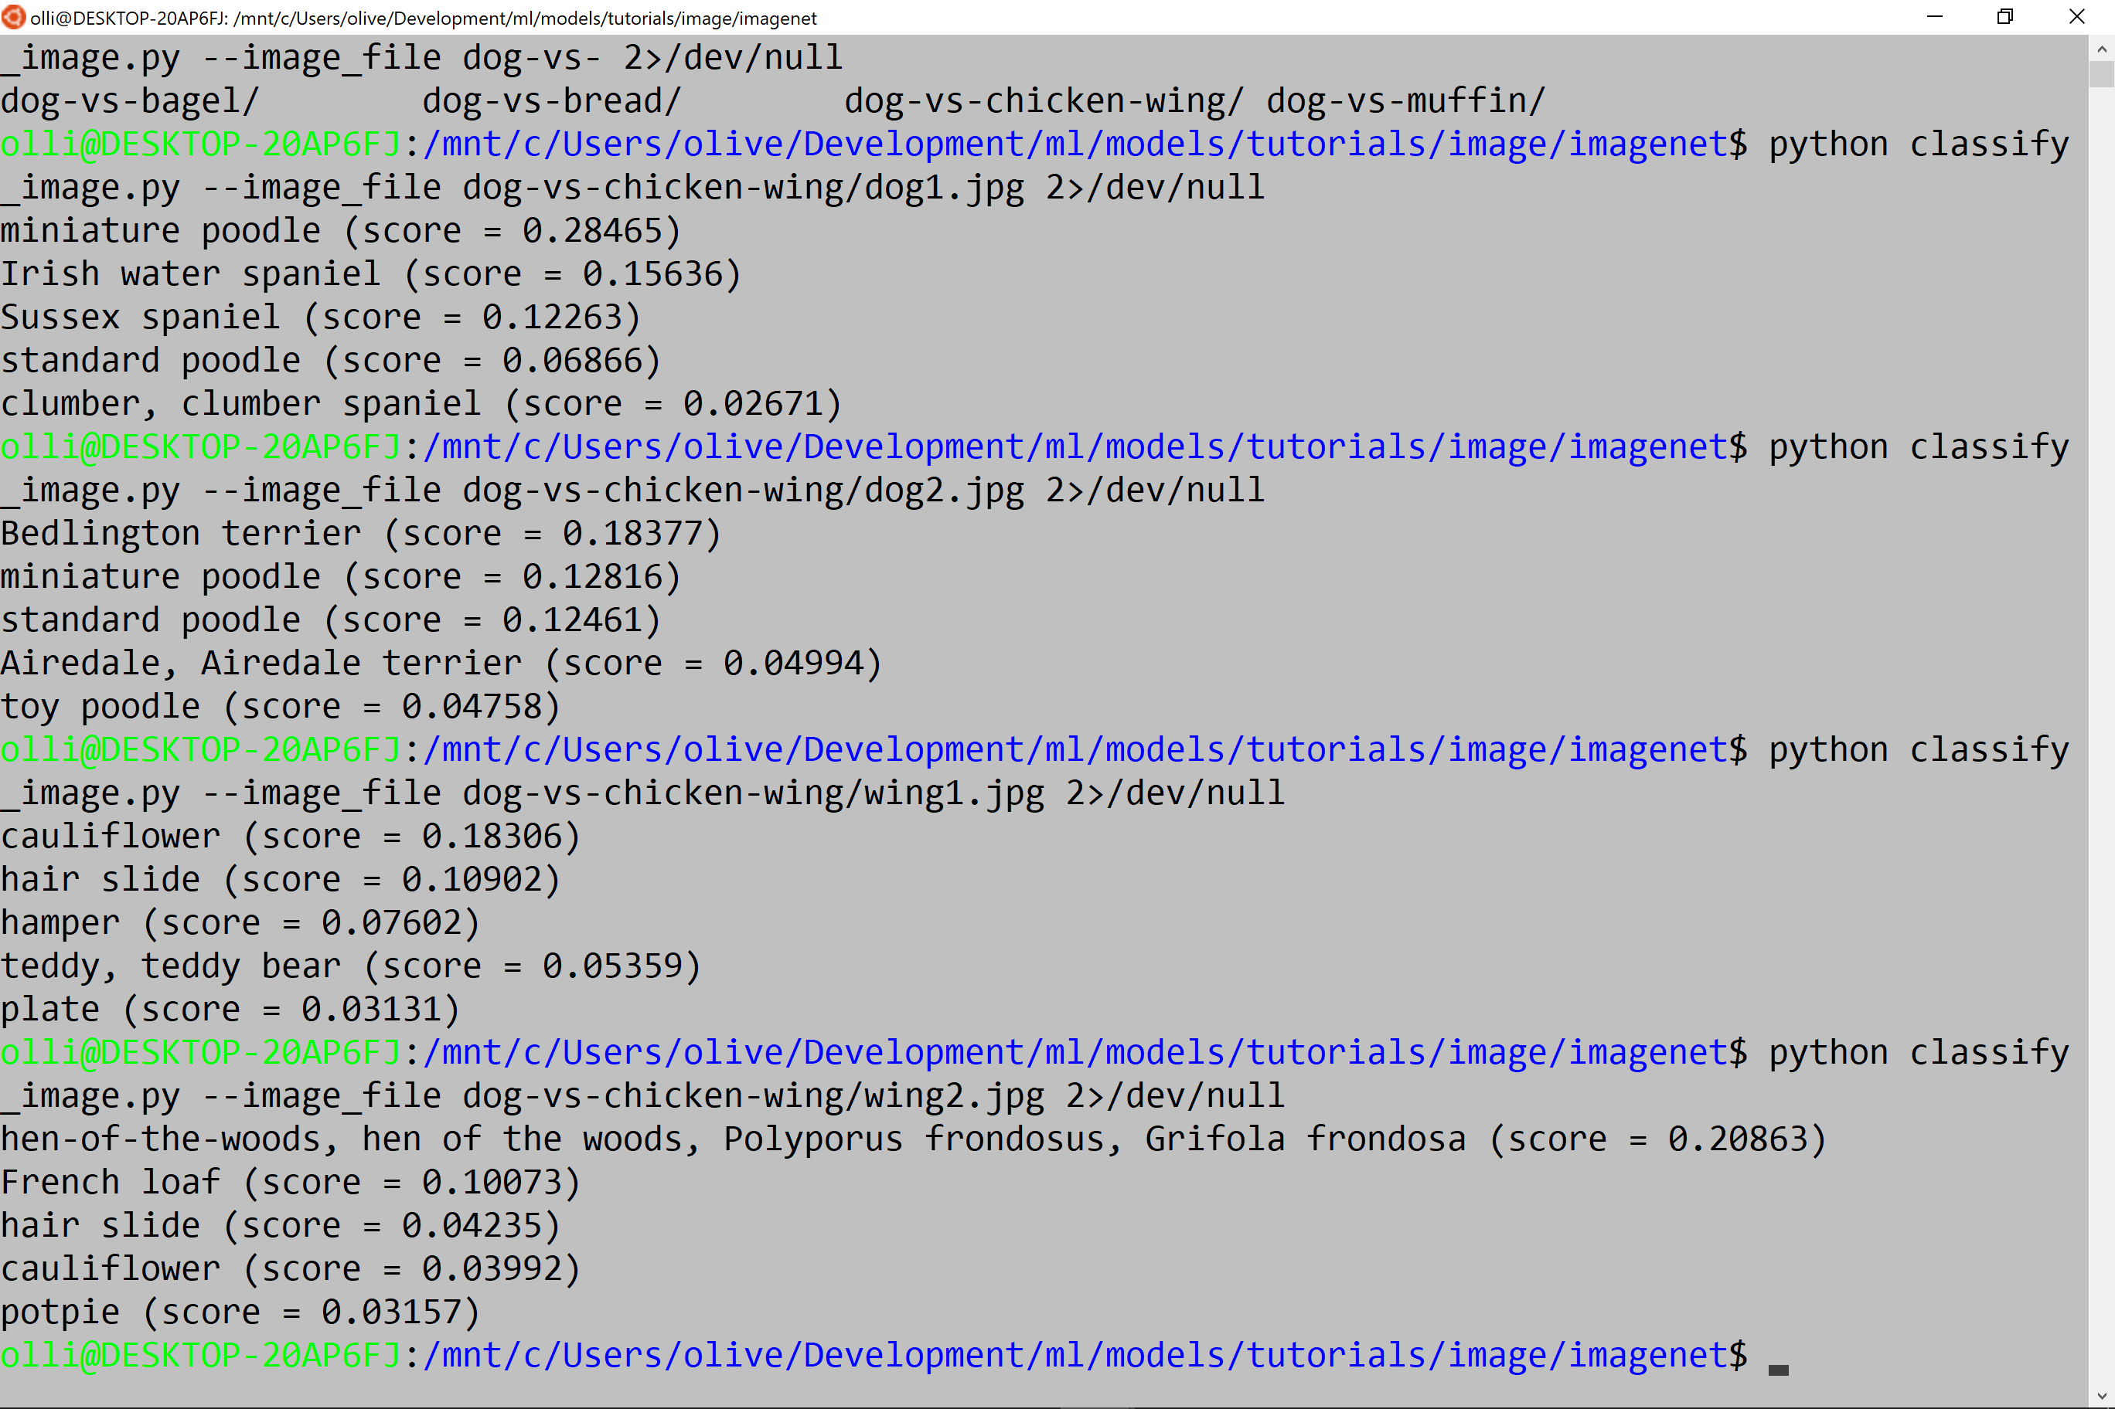

Slide 13
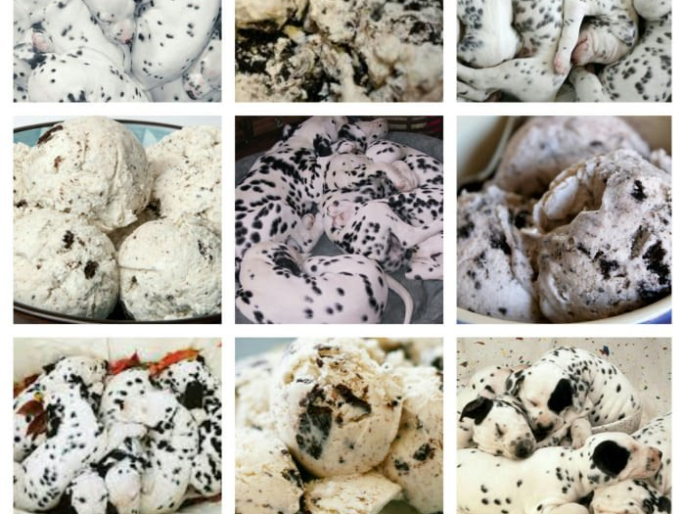

Slide 14
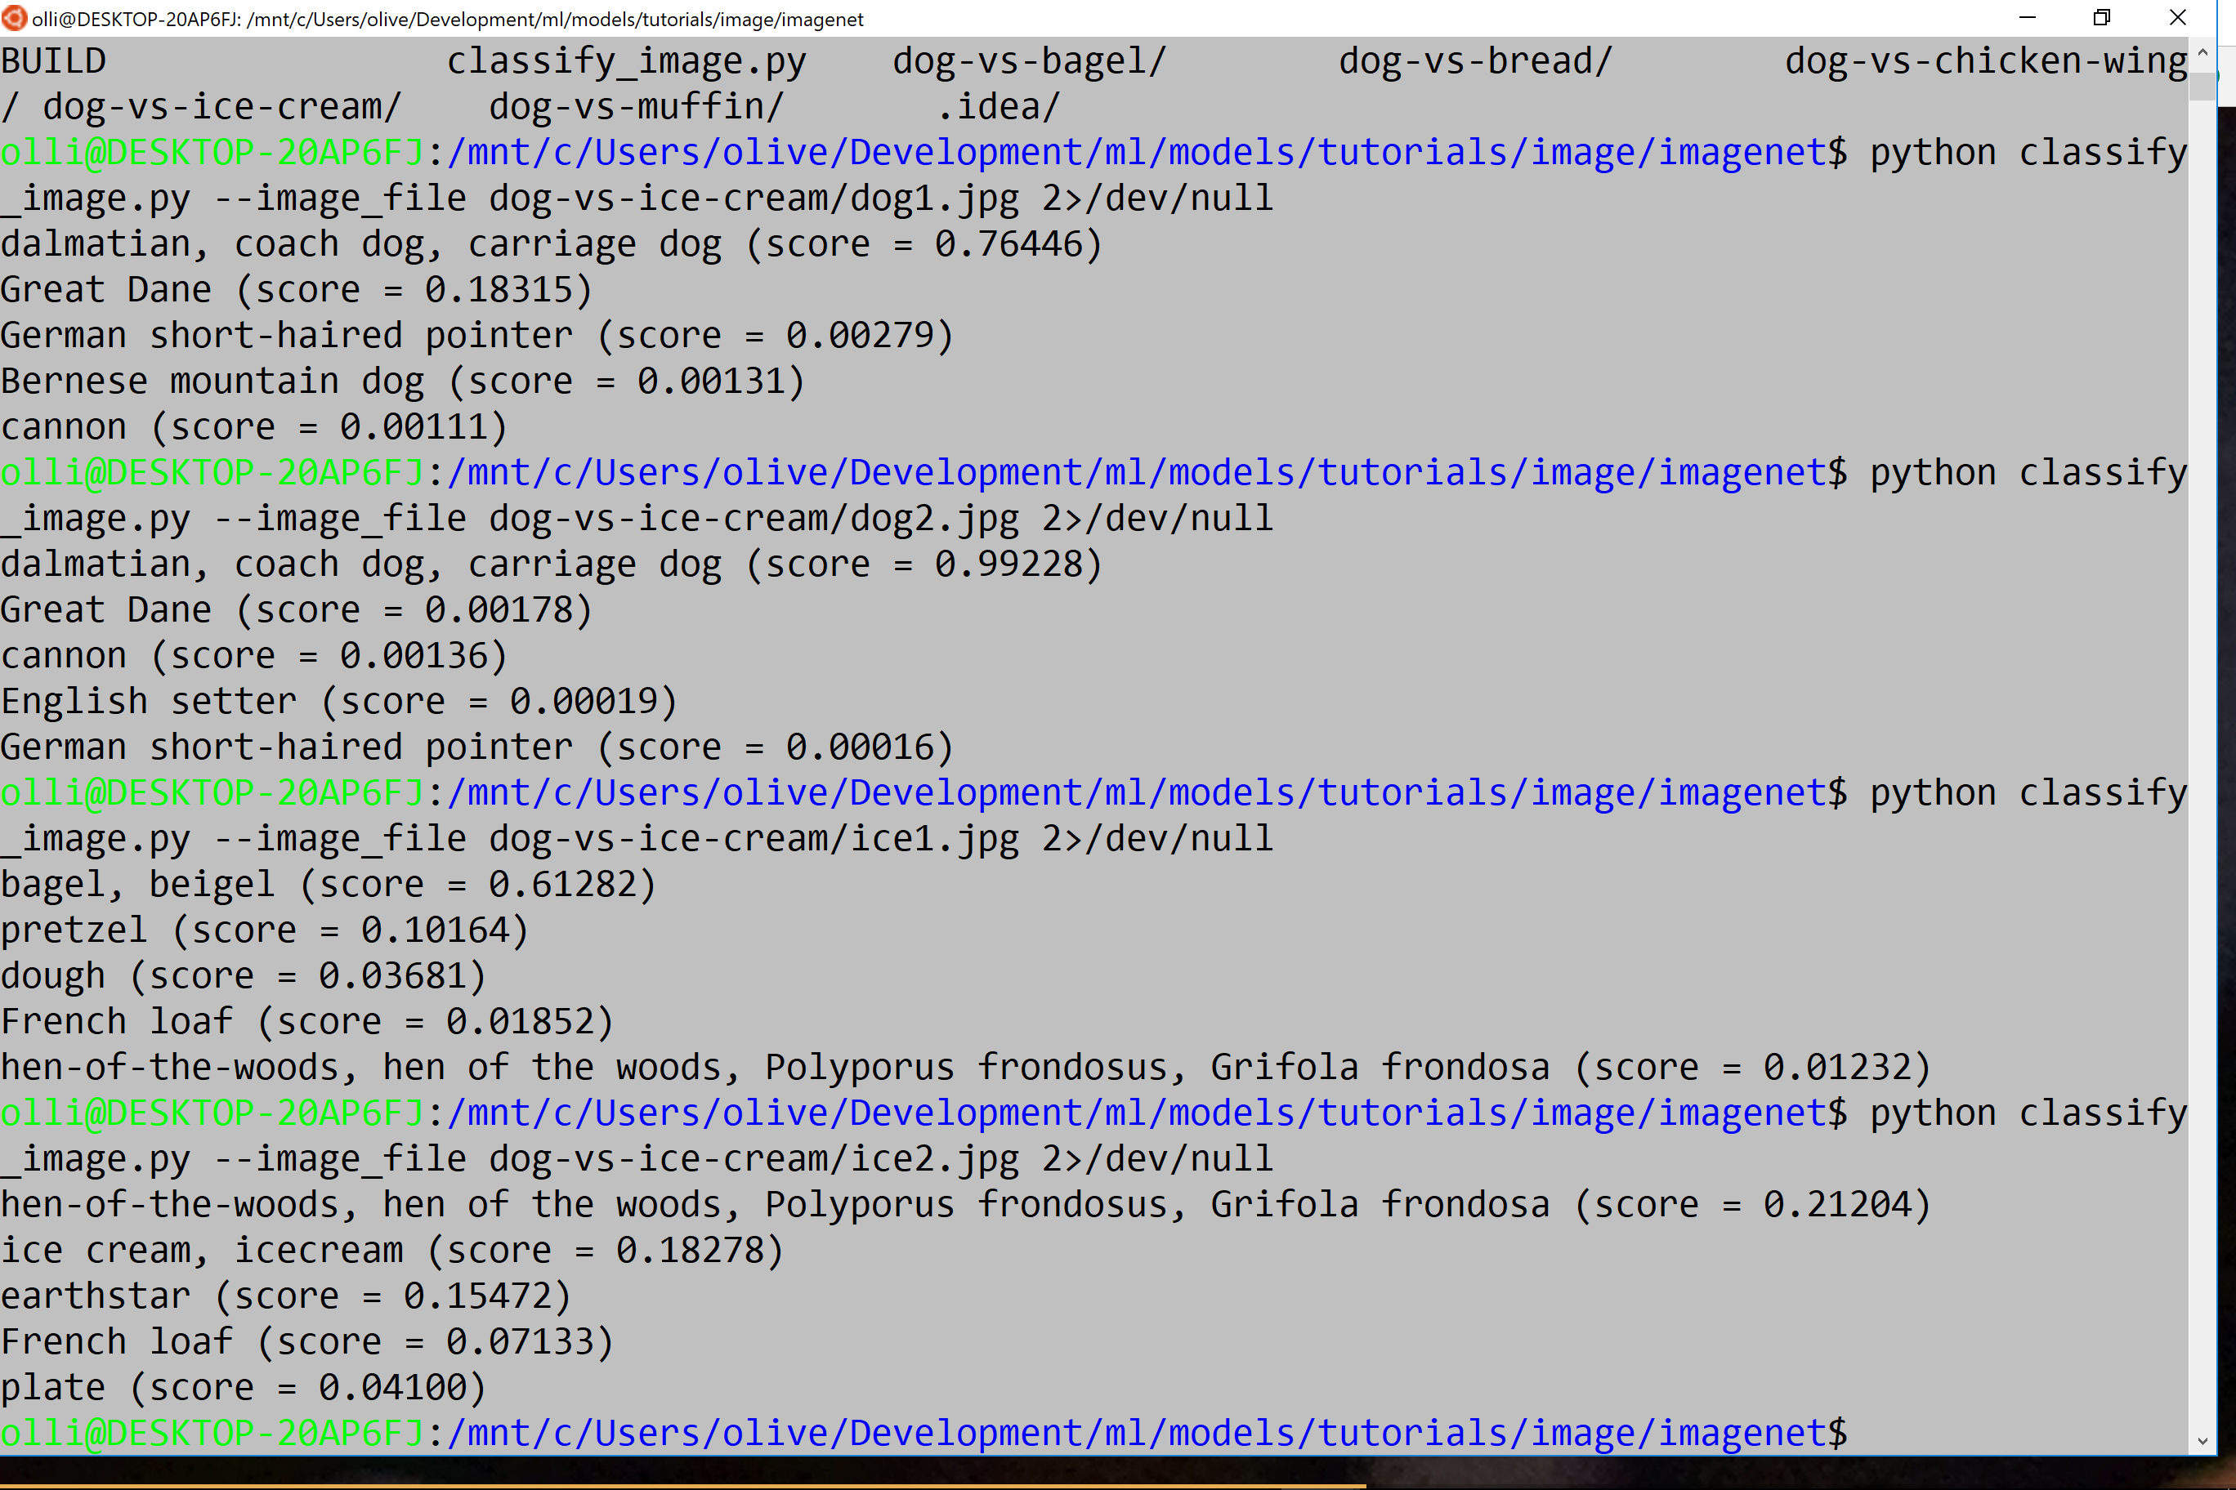

Slide 15
YES!
At least for our examples Google Inception Model knows what is a dog and what is not

Slide 16
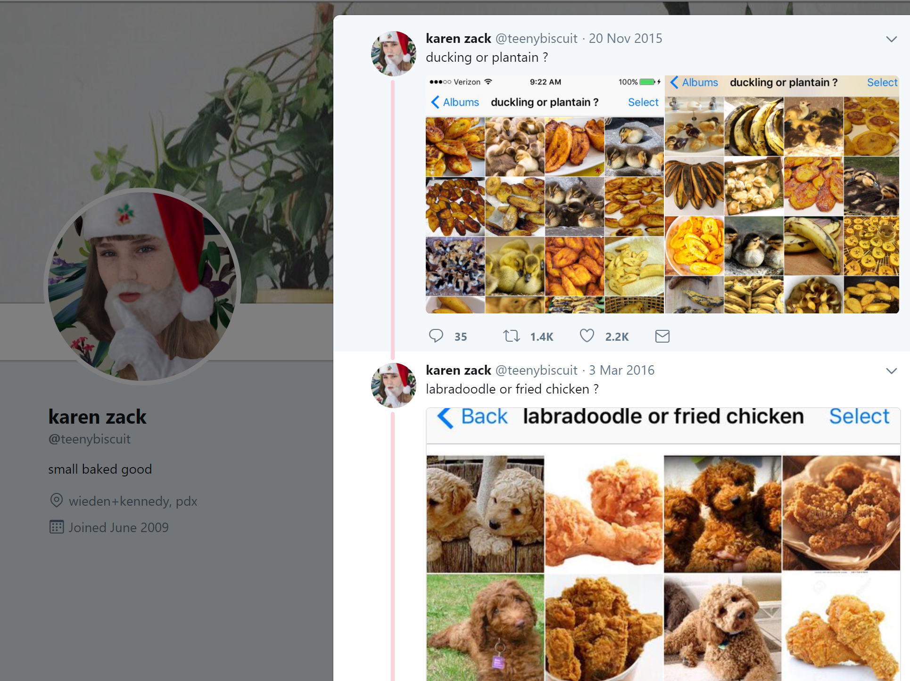
Disclaimer
These are not real Captchas
They have been created by @teenybiscuit and other anonymous artists

Slide 17
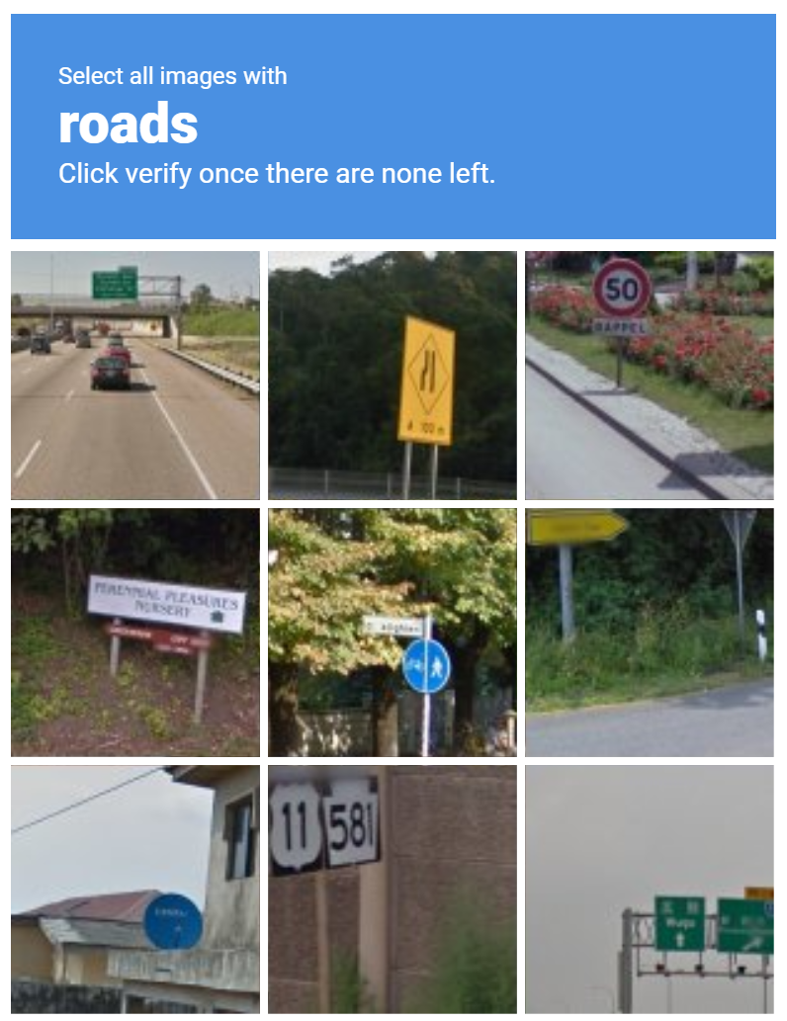
Real Captchas would rather look like this

Slide 18
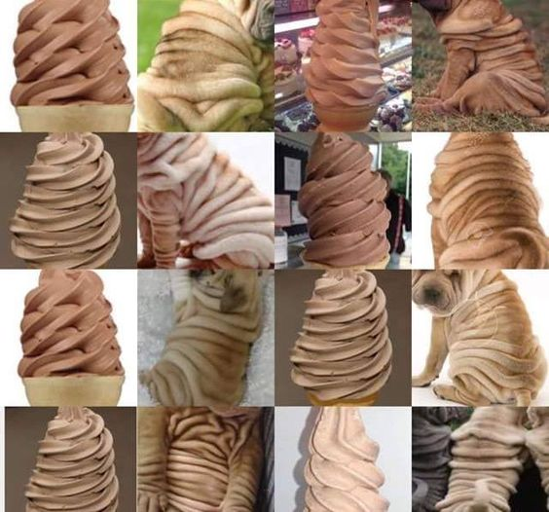

Slide 19
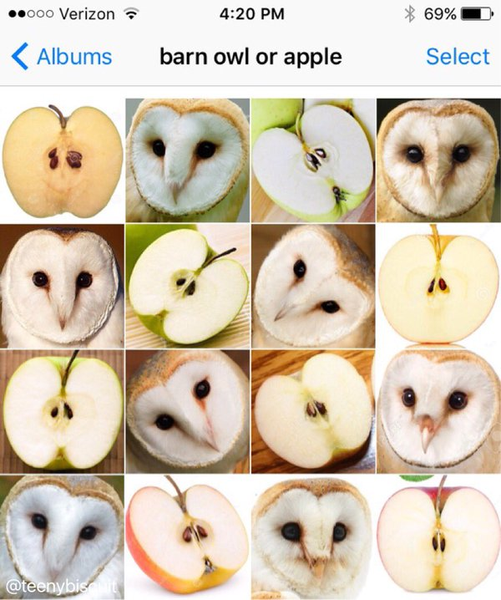

Slide 20
